Slide 1
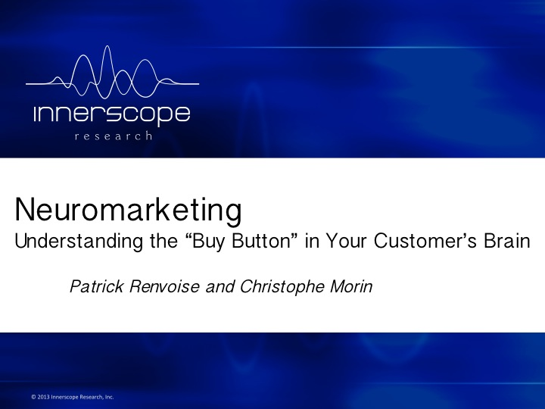
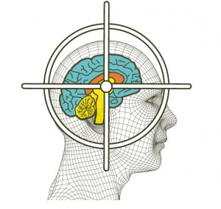
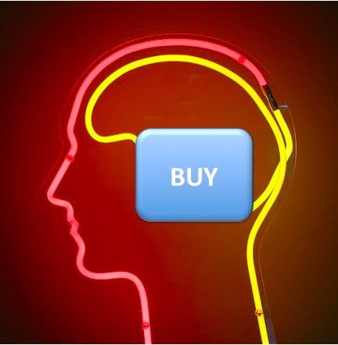
Presentation By Jacob Lazarus, University of Rochester 2014

Slide 2
The Big Picture
10,000
130 Million
8960
1.2 Million
500
1000
100 Billion
Selling Messages
Photoreceptors
Kilobits/Second of Visual Info
Retinal-Ganglion Cells
Milliseconds
Dollars (or more)
Living Cells

Slide 3
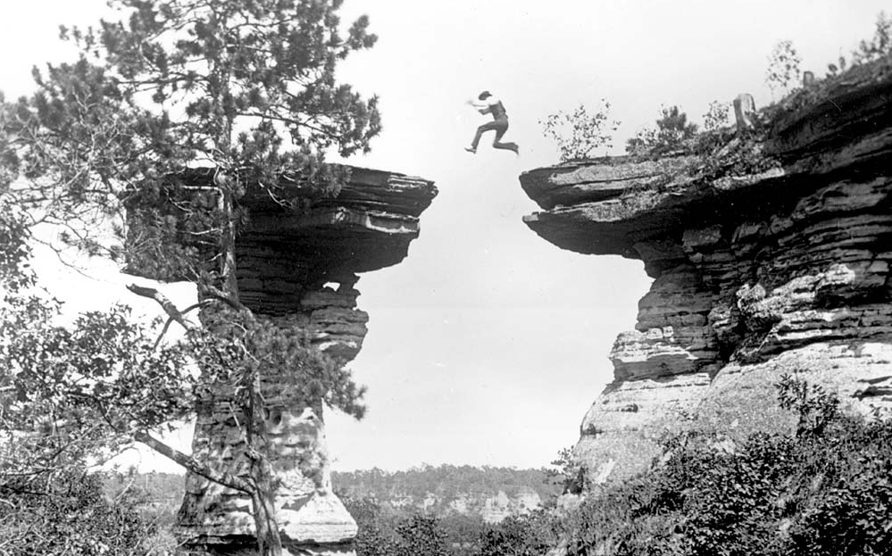
THE CHASM
Notes:
Most people aren’t innovators or early adopters. The majority are pragmatists and conservatives. We shouldn’t even worry about the skeptics because they are the people who are consistently left in the dust as innovations are adopted. We have to emphasize that neuromarketing is a must-have tool, and that those who don’t start using these services will die out. Survival of the fittest.

Slide 4
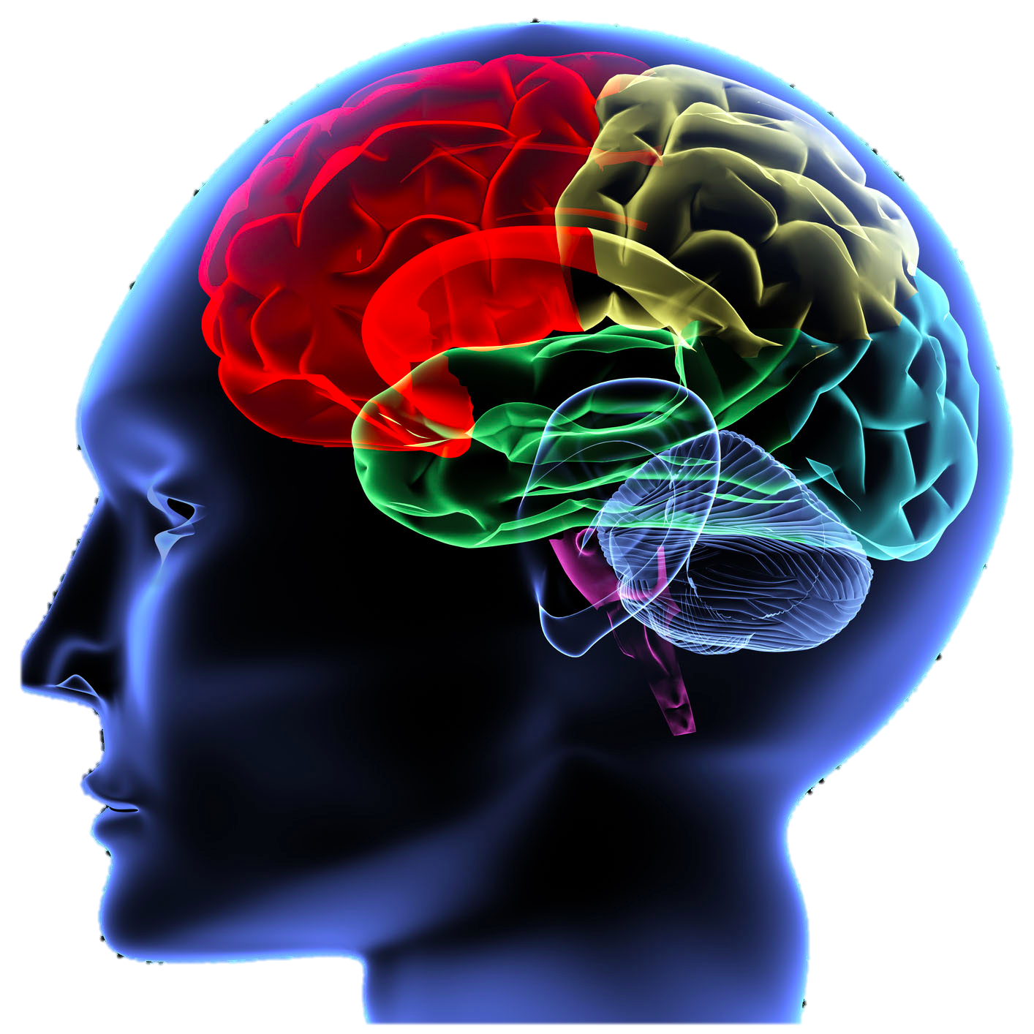

It All Started in 2002
“We are the leading provider of integrated, cloud-driven, secure…”
“Huh???”

Slide 5
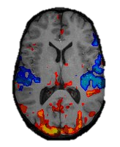

Talking Points
The Six Stimuli
The Four Steps
Message Building Blocks & Impact Boosters

Slide 6
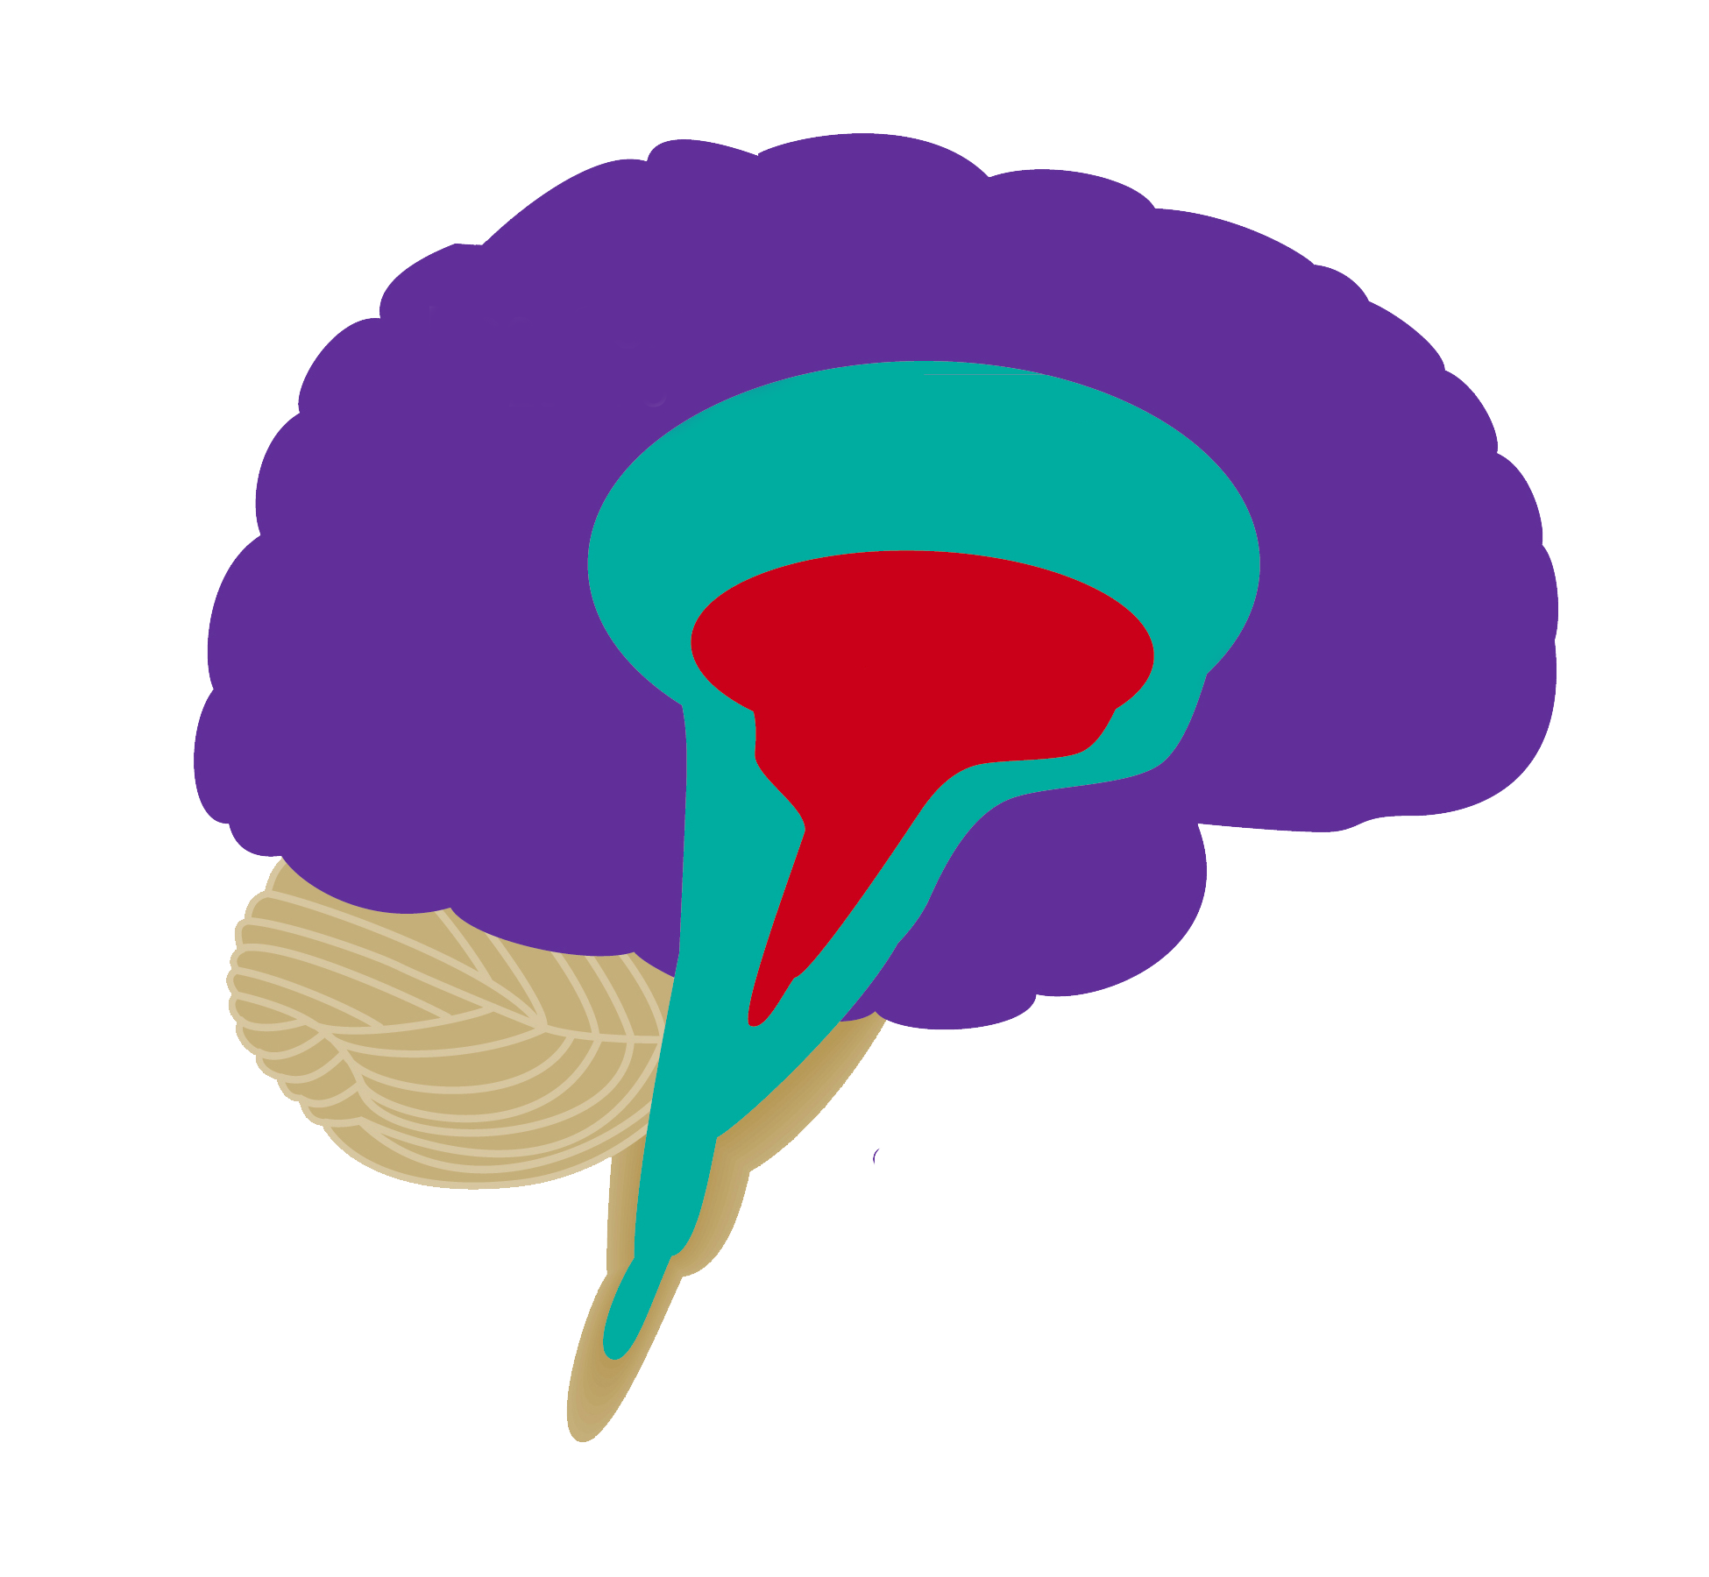
The 3 Brains
New Brain
= The Thinker
Midbrain
= The Feeler
Old Brain
= The Decider

Slide 7
The 6 Stimuli that Speak to
the Old Brain
1. CONTRAST
2.
“YOU”
3. Tangible
“Scalable Architecture”
“More Money”
“24-hour Customer Service”

Slide 8
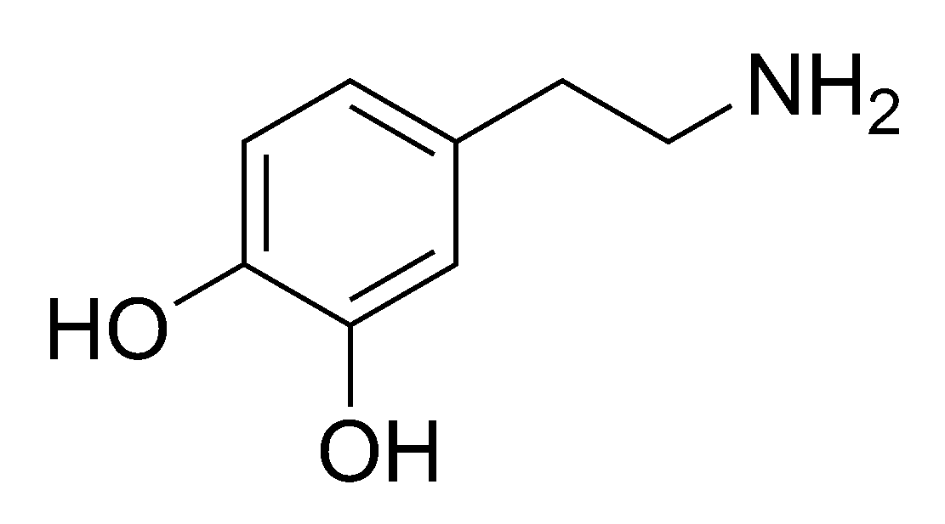

The 6 Stimuli
4. Beginning and End
5. Visual Stimuli

Slide 9


Slide 10
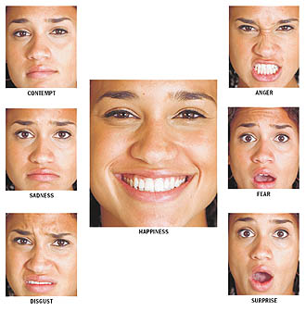
The 6 Stimuli
6. Emotion
“We are not thinking machines that feel, we are feeling machines that think.” – Antonio Damasio

Slide 11


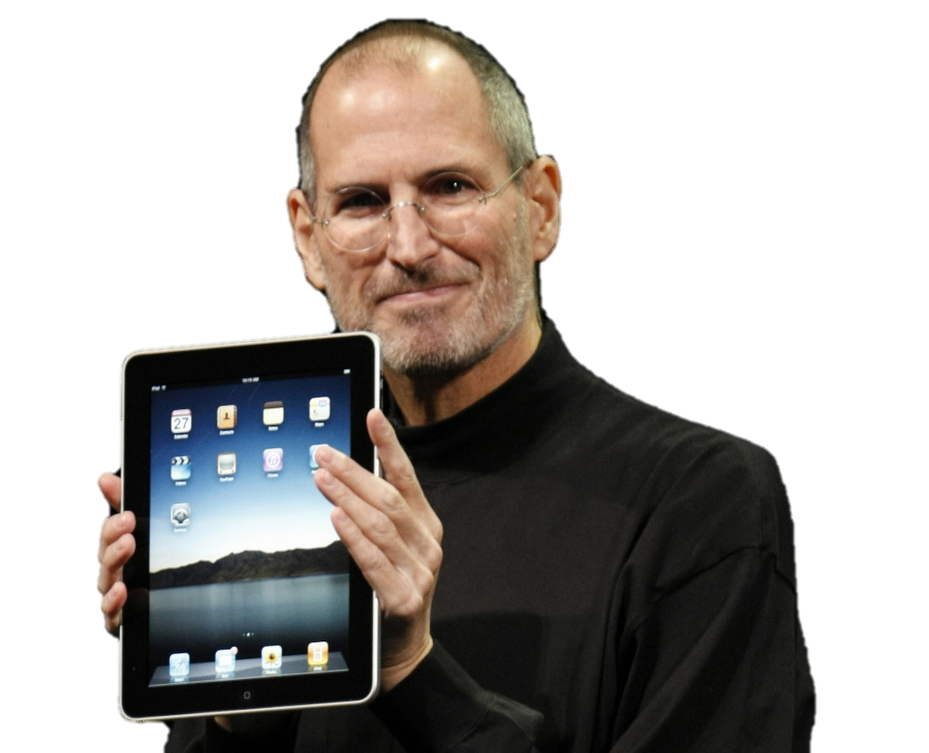

4 Steps
1. Diagnose the PAIN
2. Differentiate Your
CLAIMS
3. Demonstrate the
GAIN
4. Deliver to the
OLD BRAIN

Slide 12
Diagnose the Pain
QUESTIONS:
What is the true source of the prospect’s main pain?
Financial: $$$ Strategic: Personal: ☺
What is the intensity of that pain?
What is the level of urgency requiring the pain to be solved?
Is my prospect aware of and does she acknowledge her own pain?

Slide 13
Diagnose the Pain
GOALS:
1. Establish your expertise by the relevance of your questions
2. Establish valuable trust with the prospect’s old brain

Slide 14

Financial ($$$)
Strategic ( )
Personal (☺)

Slide 15

Differentiate Your Claims
Always sell something that is perceived to be 100% UNIQUE
Claim that you are the only company who does or has something specific
Treat your solution as an INVENTION, and build your message firmly on your claims
Eliminate the PAIN with your CLAIM to motivate the prospect to BUY

Slide 16
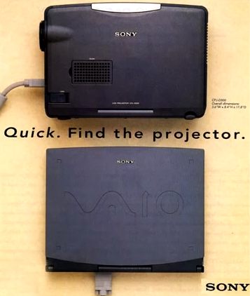
SONY
T
O
P
herapeutic
riginal
rovable

Slide 17
Demonstrate the Gain
Don’t just talk about your gain – PROVE IT!
Value > Cost
ACCOMPLISH BOTH WITH THESE 4 WAYS TO PROVE GAIN

Slide 18
Demonstrate the Gain
 | Customer Story (80-100% Proof) | A Demo (60-100% Proof) | Data (20-60% Proof) | A Vision (10-40% Proof)
Financial
Strategic
Personal

Slide 19

Customer Testimonial
Proves the Past

Slide 20
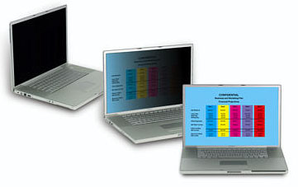
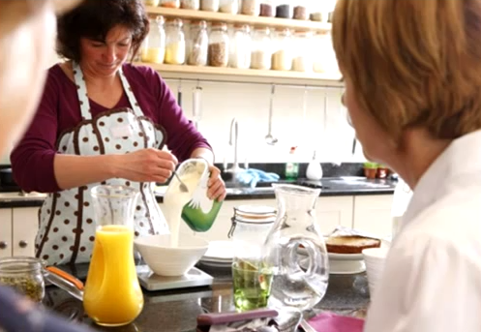
A Demo Proves
The Present

Slide 21
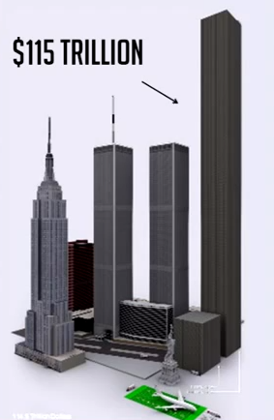
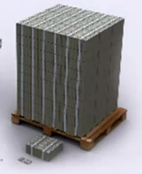
A Data Proof
is Best Visual

Slide 22

A Vision Tries to
Prove the Future

Slide 23

Deliver to the Reptilian Brain
“Power is not revealed by striking hard or often, but by striking true.”
– Honore De Balzac, La Comedie Humaine
Know how to deliver or speak to the old brain
with the following 6 building blocks, and improve your message style and delivery with the 7 impact boosters

Slide 24
The Message Building Blocks
Grabbers
Big Picture
Proofs of Gain
Handling Objections
Close
Claims
TECHNIQUES AND WAYS TO BUILD A SOLID PRESENTATION

Slide 25
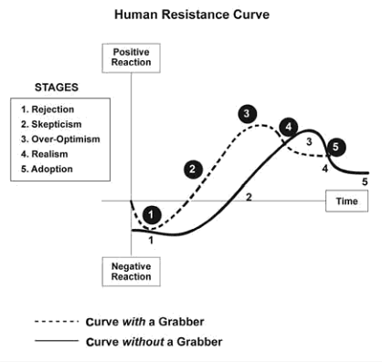
Grabbers
Mini-dramas: contrast the benefits of your product with the pains of your prospect
Wordplays: utilizing creative language to get attention
Rhetorical Questions: let the prospect’s brain produce the answer you want
Props: using an object that symbolizes the solution you are offering to the prospect
Stories: nothing says you care about your prospect more than a personal story

Slide 26
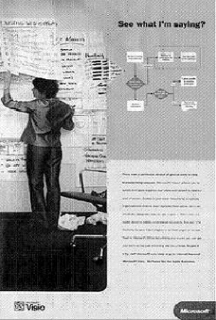
Big Pictures
Visual is Faster
Visual hits OLD BRAIN before NEW BRAIN
Visual Representations of Your Solution’s Impact on the Prospect
Design is Critical
REFLECT PROSPECT’S WORLD
TRIGGER VISUAL PROCESSING RESPONSE
Affirm contrasts – Life Before/After or With/Without Product
Notes:
Visual input reaches the brain faster than any other type of sensory information
Visual information enters the old brain WAY BEFORE it enters the conscious, new brain
Big pictures are a visual representation of how your solution can impact the world of your prospect
Big pictures have to be designed in a certain way to be BIG pictures:
They must reflect the world of the prospect
They must trigger a real visual processing response
A contrasted big picture shows the prospect’s life before/after your product or without/with it.

Slide 27
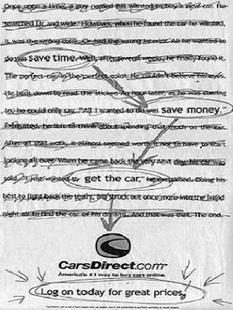
Claims
Proofs
YOUR (3) MAIN SELLING POINTS THAT SOLVE THE MOST FRUSTRATING PAINS
MAKE YOUR CLAIMS MEMORABLE THROUGH REPITITION
WORDSMITH YOUR CLAIMS TO BE AS SHORT AND SIMPLE AS POSSIBLE
Delivering tangible proofs of gain is where you should spend 70% of your selling effort
Notes:
For each claim, you must find a proof for each benefit and make a strong effort to communicate that proof in such a way that it becomes easy and fast for your prospect to believe what you say. The burden of proof is always on you, not on your customers.
For a customer story, be prepared to provide precise information such as the name of the company, with one or two names of key company people who will be willing to relate their high satisfaction with your product or service solution. Also discuss three common points between the customer in your story and the prospect listening to your presentation. A specific problem the customer was able to solve using your solution; what your customer is doing before/after using your solution
Demo – can you really show them a visible proof? Can you show an A/B comparison demo, where A would show the products of one of your competitors and B would be your products? B must be shown to be better, faster, or cheaper
Can data be accepted without objection
Vision – can you use a story, analogy, or metaphor to best prove why you believe your prospect would receive some benefit by buying from you

Slide 28
Handling
Objections
The Close
Repeat your claims one final time
Ask for positive public feedback: “What do you think?”
A positive public statement makes it more likely that they will follow up with a commitment to buy, according to the Law of Consistency
And for the next step, ask: “Where do we go from here?”
1
Restate
2
Step Into It
3
Hear/Wait
4
5
Deliver/State
Positive
Notes:
Misunderstandings →
1 Restate the objection : “It seems like you need a system that provides a certain level of performance. Is speed your concern?”
2 Step into the objection: Your prospects old brain easily recognizes fear, however miniscule, and especially body language. In fact communication experts estimate that 55% of your impact comes from your body language. When faced with an objection, we are naturally inclined to move away from a threatening or negative situation. By moving forward you are sending a very strong message to their old brain: you are not afraid of the objection.
3 Hear the prospect out, you’ll need to understand his point of view in order to overcome his objection.
4 Deliver the proof: tell a story, offer a testimonial, conduct a demo, or present the result of an independent benchmark or a matrix where you report the performance level of your competitors.
Handling valid objections is a little different, wait for feedback to convince the prospect you are in tune with their concerns, state your personal opinion, and then present a positive side to the objection.
Law of Consistency: once someone has made a first step in a particular direction, his or her old brain will want to remain consistent with their original decision.

Slide 29

Impact Boosters
1. Wording with “YOU”
YOU

Slide 30

Impact Boosters
2. YOUR Credibility
Your creativity
Your fearlessness
Your passion
Your integrity
Your similarity
Your expressiveness
“To be trusted, look, feel, and sound like your prospects best friend.”
Notes:
Your creativity: dare to be different
Your fearlessness: demonstrate self-confidence
Your passion: enthusiasm is contagious
Your integrity: it is the only way to go
Your similarity: identify with your audience
Your expressiveness: reinforce your message with your words, voice, and body language

Slide 31

Impact Boosters
3. CONTRAST
Before/After
Without/With your solution
You/Your competitors
Now/Later
“Sharp contrast helps your prospect’s old brain make a decision more quickly and easily.”

Slide 32
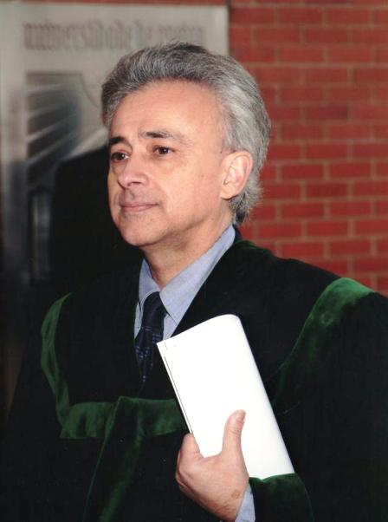


Impact Boosters
4. Emotion
5. Learning Styles
bell
Notes:
No emotion, no decision. Poweful emotions mark your old brain reach straight to its core.
Damasio proves that the subconscious part of our old brain becomes aware of critical facts before they actually reach our consciousness. He gave test subjects four decks of cards, and asked them to pick a card from any of the four decks to reveal a reward. Two decks were rigged to produce an overlall loss in play money, and two produced gains. At intervals, participants were asked what they thought was going on in the game. Meanwhile, they were hooked up to machines that analyzed galvanic skin responses, similar to how we do it here at Innerscope. By the tenth card, they began should a measurable physical reaction in the form of GSRs whenever they reached for a losing deck. But not until they had turned, on average, thirty cards ,could subjects verbalize their hunch that two of th decks were riskier. Incredibly, some players were never even able to figure out the pattern of the game.
Although all people use the three learning channels – visual, auditory, and kinesthetic – everybody has a favorite one or unique pattern of utilization. To address your audience effectively, vary your learning channels. Your message is apt to be primarily auditory: make it more visual and kinesthetic by using real pictures, props, exercises, mini-dramas, and stories.

Slide 33
Impact Boosters
6. Stories
7. Less is More
YOUR BRAIN CANNOT TELL THE DIFFERENCE BETWEEN REALITY AND A WELL-TOLD STORY
MORE WORDS DO NOT EQUAL MORE IMPACT. TELLING DOES NOT EQUAL SELLING. REMOVE ANYTHING THAT HAS NO VALUE TO YOUR PROSPECTS

Slide 34
Targeting Prospects
Diagnose the pain, differentiate your claims, demonstrate the gain, and calculate your cluster attractiveness:
(PAIN) x (CLAIM) x (PROVEN GAIN)
= Your Cluster Attractiveness
The higher values of cluster attractiveness are the groups of prospects that will be easiest for you to close.
Next, determine your cluster opportunity by multiplying your cluster attractiveness by the size of that cluster.
This will help you figure out what sort of marketing strategy to employ. Going after the wrong market can be costly and a waste of time.

Slide 35
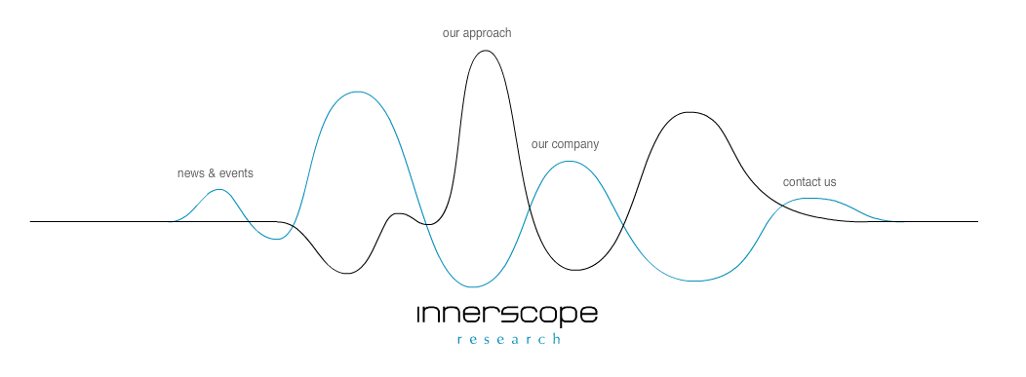
The Website
Know exactly who your target audience is and what the objectives of the site are. Choose two or three main claims. Develop your proofs of gain by building a value matrix → what sort of pains have you solved for past clients with your services, and what solutions can you offer to prospects? Use grabbers, repeat claims, and provide details to deliver to the old brain.

Slide 36
Presentations
Invest in Preparation
Know your Objective
Understand the Prospect’s Pain
Differentiate!
Limit the Strong Points
Grab the 1st Impressions
All to Create a Powerful Presentation
Shorten Bullets
Notes:
Invest a lot of time preparing
Objective = receive a close or move the sales process forward
Find out as much as possible about the pain of your target group
Differentiate your claims by learning as much as you can about your competitors
Use only your strongest proofs of gain, and those that are most relevant to the prospect at hand
Use a grabber to create a strong first impression, a big picture to create understanding, and powerful claims to help the prospect remember your unique benefits
Utilize powerful presentation elements by carefully constructing your message for maximum impact to the old brain
Make it short and Focus on your Close

Slide 37
In Conclusion
Neuromarketing
Marketing
Simple
Brain Model
Sales
Notes:
Congratulations, you have finished learning about the most effective ways to increase your influence in all your sales, communication, and even in your personal life. By understanding the buy button in your prospects brain, you will not only enjoy the tremendous power of creating and delivering powerful messages that influence people, but you will also recognize how others influence you by speaking to your own old brain.
You have discovered a powerful framework for a completely new way of looking at selling and information processing based on the latest brain research. Much of the technology used by neuroscientists today is out of reach for most companies. Most will not be able to afford an MRI study to find out what color packaging will most likely sell. By learning the old brain theory, anyone in marketing, sales, or advertising can expect to get a more effective, predictable, and repeatable results, and a strong response from the prospect.
Neuromarketing provides a common language for sales and marketing functions. In many companies, sales and marketing don’t share a common platform to communicate, and the business pays the price of a house divided. Neuromarketing allows companies to not waste resources and time on poor communication and diluted sales and marketing functions. The two departments can coalesce around the four simple steps:
Diagnose the pain, not just the wishes, wants, or needs
Differentiate the company’s claims, more concrete than positioning
Demonstrate the gain, prove that the value proposition is the core of selling
Deliver the message to the old brain – help people understand and trigger a decision or closing.
AS an individual your mastery of all these concepts will make you much more valuable to your company and to your clients. So how can you afford to miss an opporunity to reach the old brain of your audiences in such a consistent and powerful way? I seriously recommend all of you read this book, it taught me many invaluable lessons that have already provided me with success and results in all sorts of situations. Neuromarketing is as much a form of communication and a system through which influence can be administered, and I look forward to discussing its concepts and nuances with all of you in the future. But for now, what do you think?

